Slide 1

2?4> Concept Explainer Presentation
Peter Evers T: 00 353 86 8581 921 E: Peter.Evers@iadt.ie

Slide 2
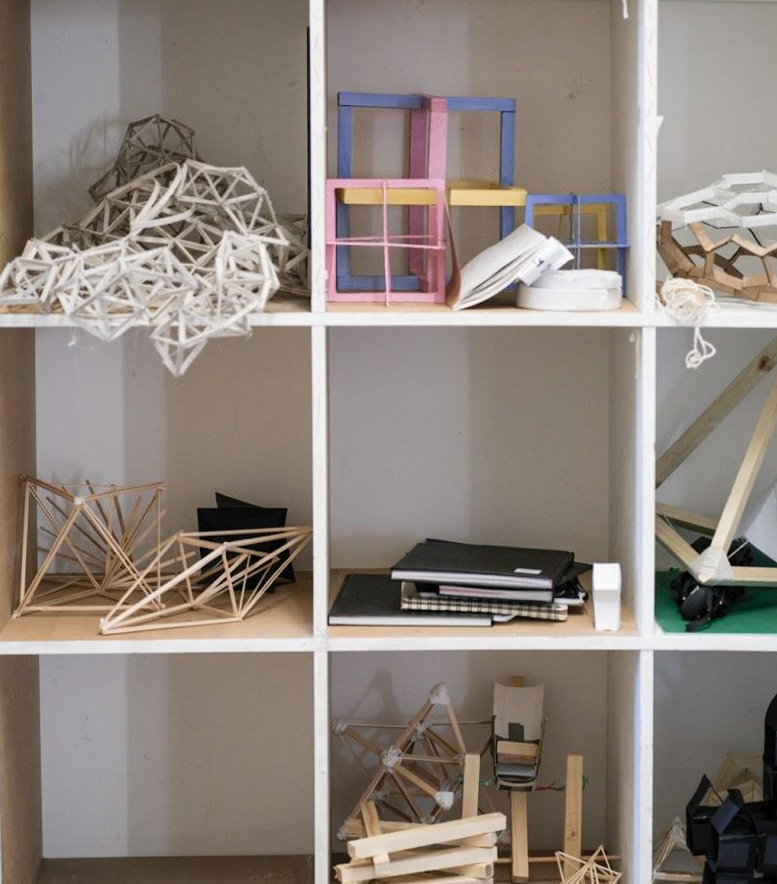
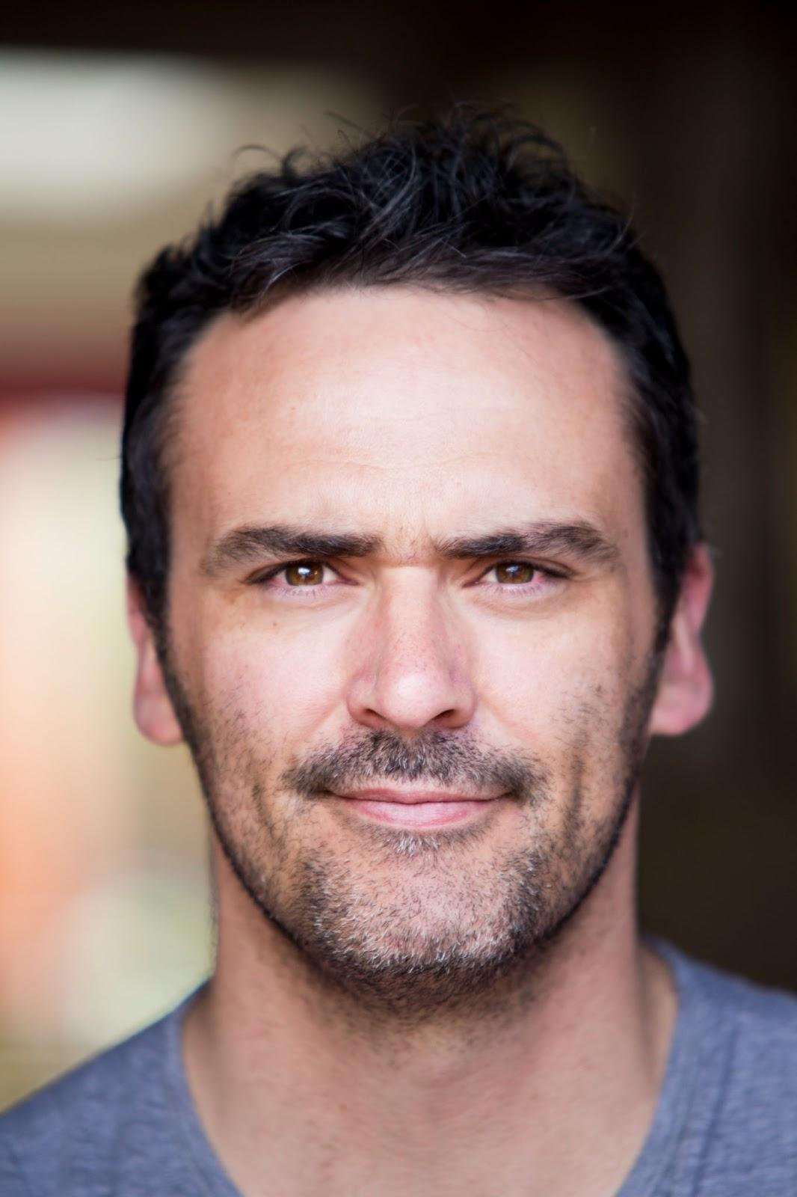
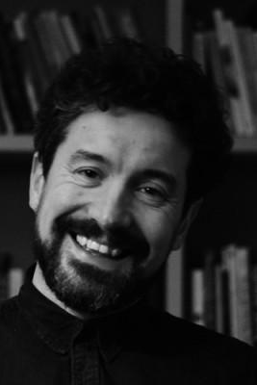
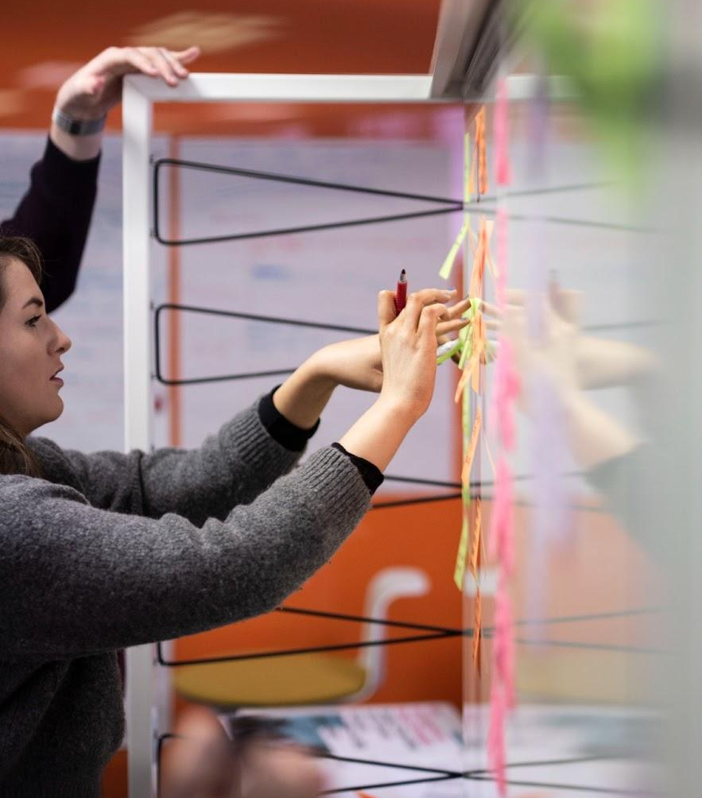


Peter Evers
Peter Evers is visual artist, researcher and educator at IADT. He is also a researcher
at PDL, 2?4>.
Clyde Doyle
Clyde Doyle is a researcher, educator and designer. Chair of MA in Design for Change at IADT. Researcher at PDL, 2?4>
Notes:
WHO ARE WE?
Introduce Peter & Clyde followed by IADT & PDL
IADT is a leader in higher education with a specialist focus on the development of future makers, shapers, technologists, thinkers, storytellers and creators who lead and innovate in a changing digital world.
The Public Design Lab (PDL) drives a vision for IADT to collaborate and consult with industry, government and civic partners, and to develop advanced research with positive social and environmental impact. These collaborations will innovate, drive policy development and produce socially engaged graduates with the skills and experience required to contribute to economic, social and cultural development in ethical and ecologically sustainable ways.

Slide 3
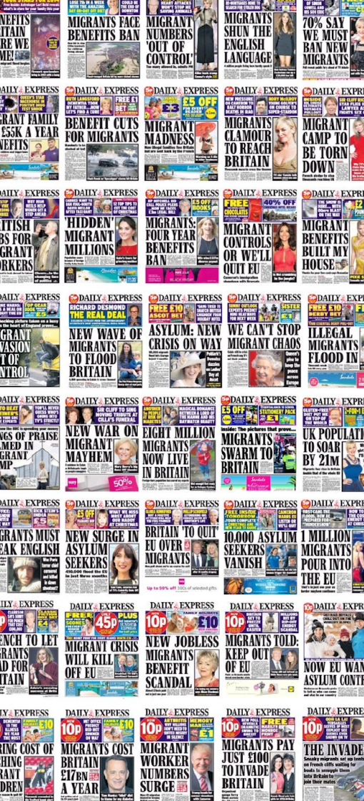
Introducing 2?4> Too Stupid for the Future
While humans are capable of great thought we overestimate
our cognitive capacity.
We struggle with rational decision making and this has contributed
to our current climate & civil rights crises.
We are pattern making creatures, incredibly suggestable
and in an accelerated world we increasingly make hasty judgements.
2?4> Concept Explainer Presentation
Notes:
CONTEXT SLIDE TO OUTLINE THE PROBLEM & BACKGROUND LEADING TO THE DEVELOPMENT OF 2?4>
It’s about thinking

Slide 4
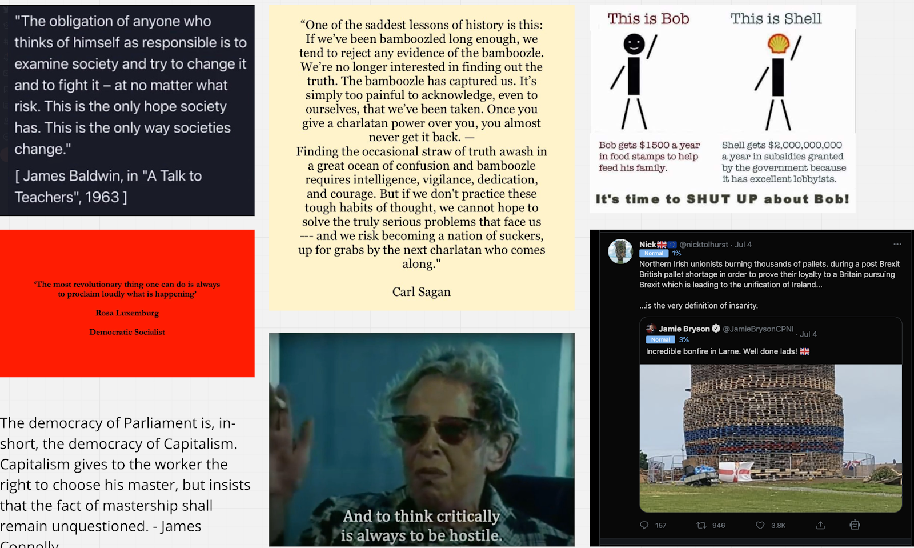
What is 2?4> Too Stupid for the Future
2?4> is an organising principle...a viewpoint...a movement for action research groups, currently in early concept stage.
2?4> wants to compassionately acknowledge and address the flaws
in our understanding, perceptions and values that are affecting our decision making and impacting the way in which we solve the world’s
great problems.
Funding is sought to initially run a 15 week studio for IADT 3rd level
students to propagate rationality and ethical decision making for
the well being of the living world.
Notes:
CONTEXT

Slide 5

The delivery of 2?4>
Initially envisaged that 2?4> would be
a substitute for work placement of 3rd level students in IADT. Delivered by lecturers with optional voluntary delivery from 3rd parties.
The provision of education in custom studios, charrettes, modules, open workshops and experiments.
It will engage with problems
of decision making.
Data - What data can be considered,
is it reliable and thorough?
Time - How much time is needed
to consider? How does our perception
of time affect our decision making?
Thought - How are we thinking, what tools are we using?
2?4> Concept Explainer Presentation
Notes:
METHODOLOGY
1. 2?4> studio: Y3 students mandated to participate in Real world work experience can request to work in our wicked problem lab. Lab mimics professional workplace. Wicked Problems are from 2?4> (problems of Data, Time and Thought) method and practice is design thinking led (Charrette Style) mixing inductive, deductive and abductive reasoning. The ethical framework/manifesto of the PDL is adhered to. Further the is opportunity within existing curriculum to conduct research it does not however offer the same depth in solution but does offer the opportunity to educate the core insights.

Slide 6
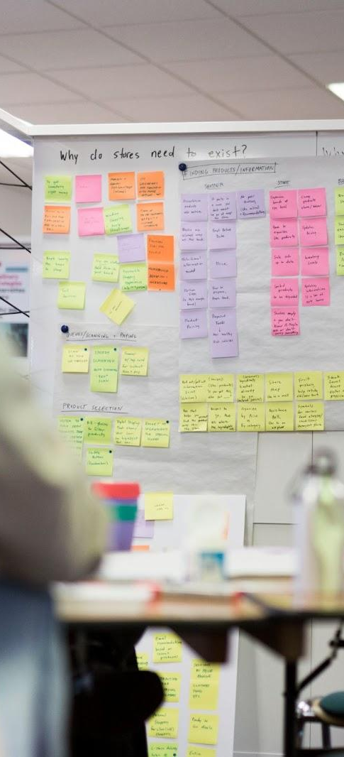
Outputs of 2?4>
Produce solutions, strategy and argument.
Communications; Audio/video/data visualisation outputs
to generate understanding and conversation.
Engagement & outreach; The use of podcast platforms,
seminars, workshops & conferences in non academic spaces.
Partnerships with governance and Civil Service.
Notes:
2. Visualisation, Mapping and thinking tools. We will develop visualisations of unconsidered data sets, map systems, create wikis etc and publish open source so that findings have pragmatic research value. Create thinking tools/methods to help foster a more deliberative democracy.
3. Outreach -
Podcasts, talks, conferences and workshops in non academic spaces. For proliferation of concept and building momentum
Should there be a movement toward more progressive practices in governance (eg expanded use of citizens assemblies, Media regulation etc) we would be available to assist in developing these practices subject to funding and ethical alignment. In the absence of governance developing strategies we would work independently on same through 3rd level modules our through the proposed studio communicating the ideas through our channels to the public and lobbying gov for adoption etc.
I have no yet contemplated corporate partnerships though I see opportunity for recruitment of participants (who feel unfulfilled at the work) and recognise the potential value or working with Corporate responsibility officers.

Slide 7
Outcomes of 2?4>
To build awareness of the issue
To build momentum for change
Facilitate conversation & debate
To advocate for better decision
making (for the well being of our
living systems and our lives within it)
To create a rallying point, make pragmatic tools and research for change (Media regulation, democracy tools, deradicalisation tools. eg weighted decision matrix)
Become a resource for others in terms of sharing 3rd party (open source) resources and through the generation of pragmatic 2?4> research tools.
2?4> Concept Explainer Presentation
Notes:
Outcomes

Slide 8

Thank you
For more information contact:
Peter Evers
T: 00 353 86 8581 921
E: Peter.Evers@iadt.ie

